Slide 1
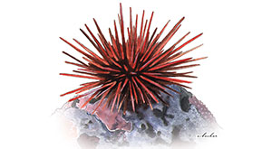
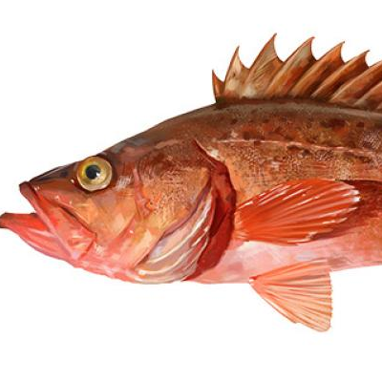
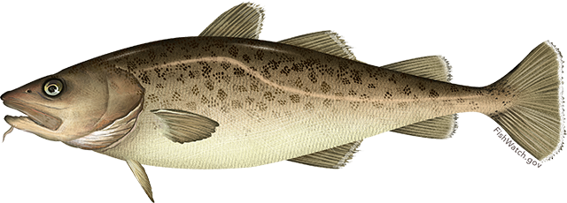
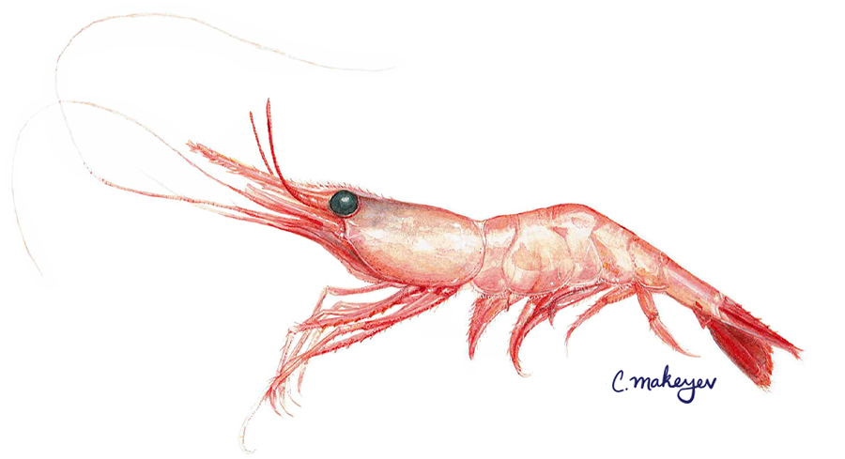
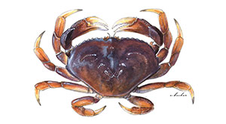
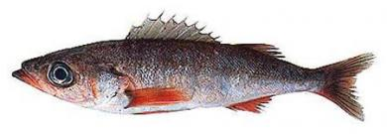
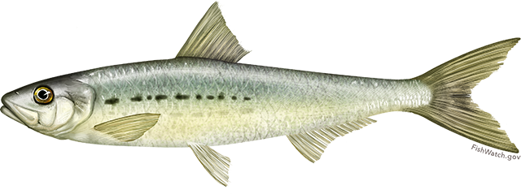
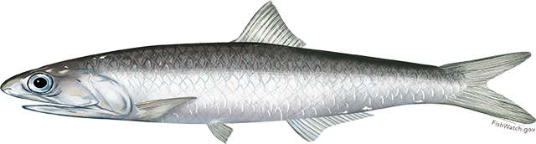
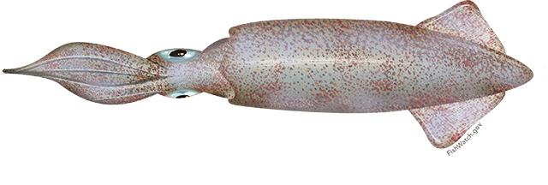
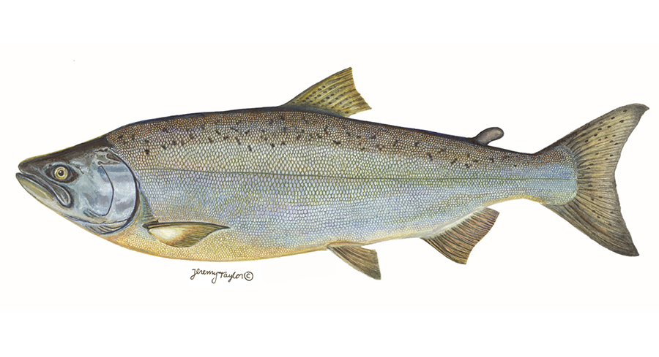
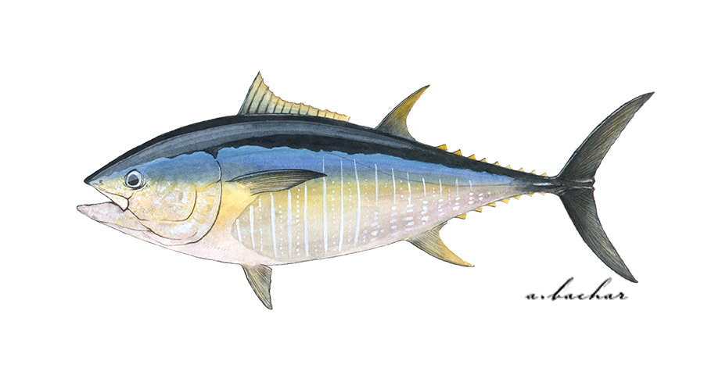
Kelp, urchin, abalone
Population declines and fishery closures due to loss of kelp beds.
Bocaccio rockfish
Enormously high recruitment rebuilt this previously threatened fish stock.
Pacific cod
Population declines due to reduced prey availability and increased metabolic demands.
Shrimp species
Revenues spiked mid-heatwave due to record high prices and strong recruitment before the heatwave.
Dungeness crab
Fishery closures due to harmful algal blooms and whale entanglements.
Shortbelly rockfish
Increases in abundance approached bycatch limits in Pacific hake fishery.
Sardine and anchovy
Low sardine productivity and high anchovy productivity reversed expectations for warm years.
California market squid
Increases in distribution created an unregulated emerging fishery.
Chinook salmon
Overfished due to reduced productivity and model failure.
Pacific bluefin tuna
Increased abundance was a boon for the recreational fishing industry but caused early closures in commercial fishery.
Direct negative impacts
Indirect negative impacts
Neutral
impacts
Positive impacts, w/ higher mgmt. challenges
Positive impacts, w/ lower mgmt. challenges
Social-ecological impact of the heatwave

Slide 2
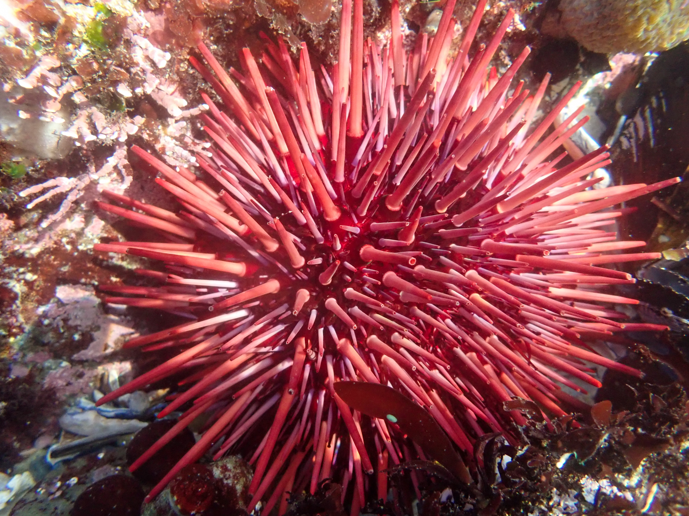
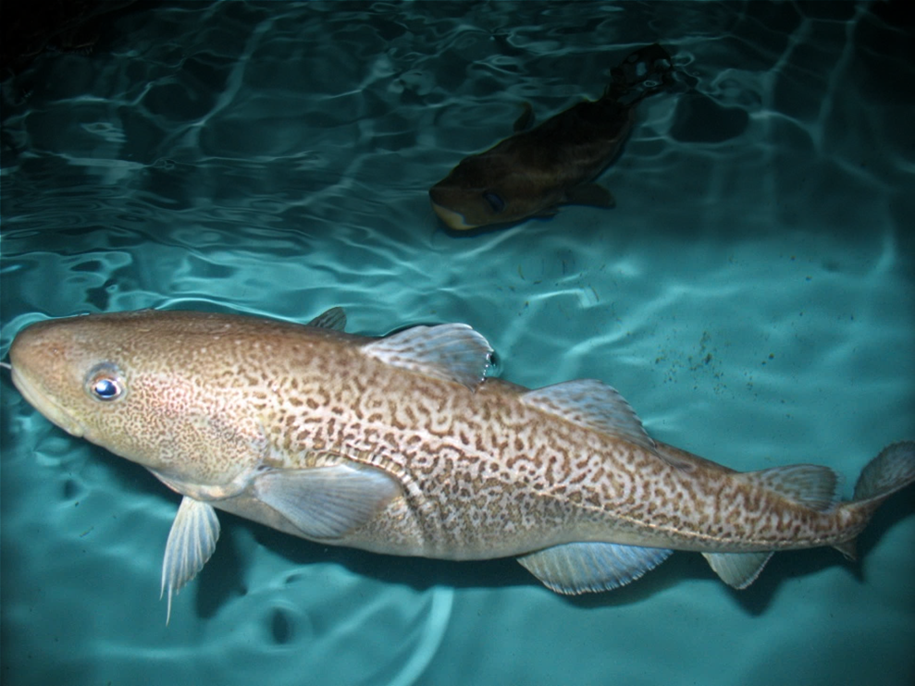
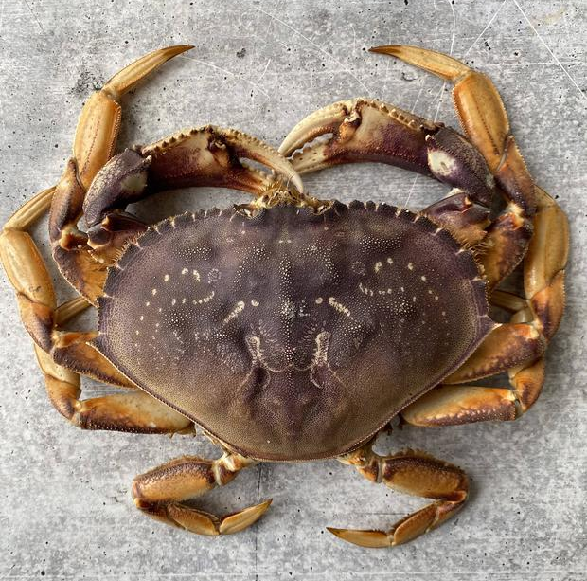
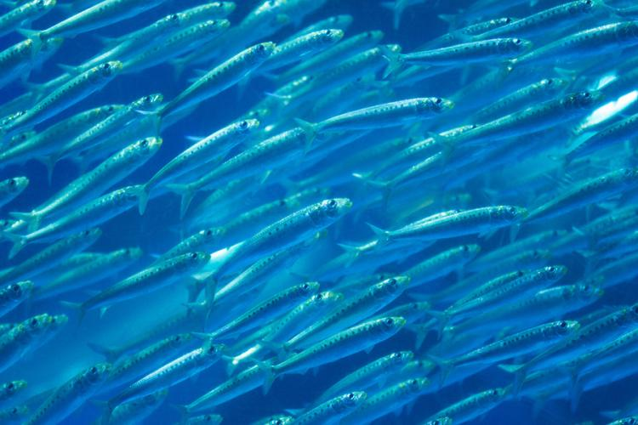
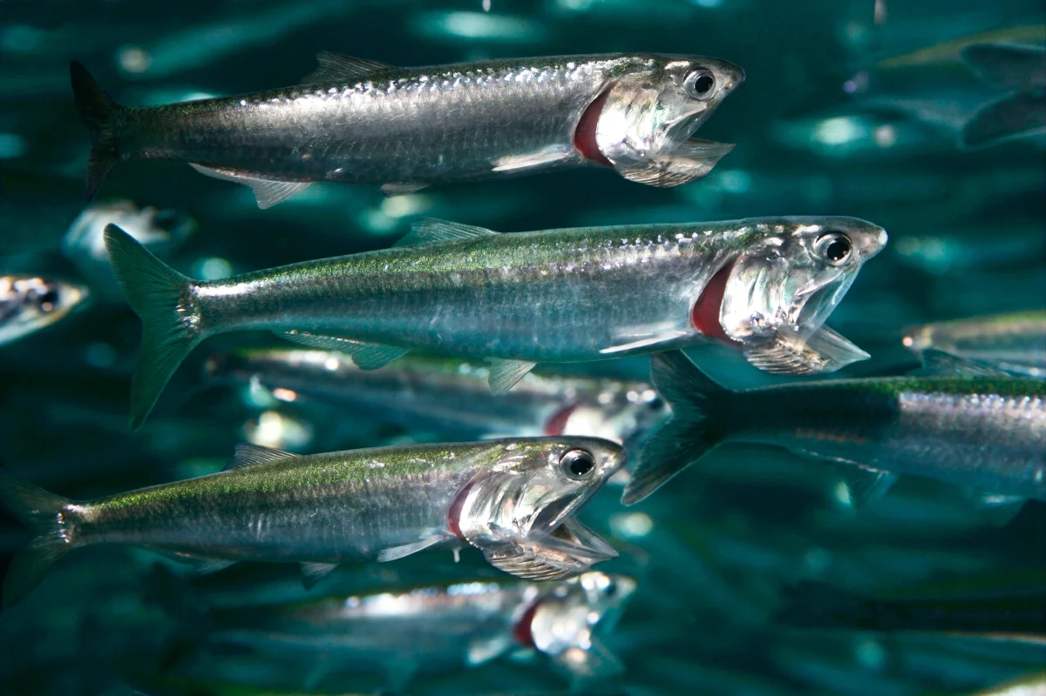
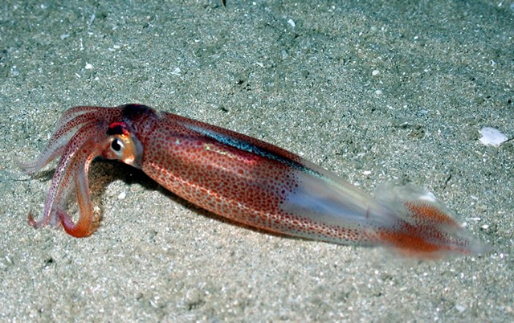
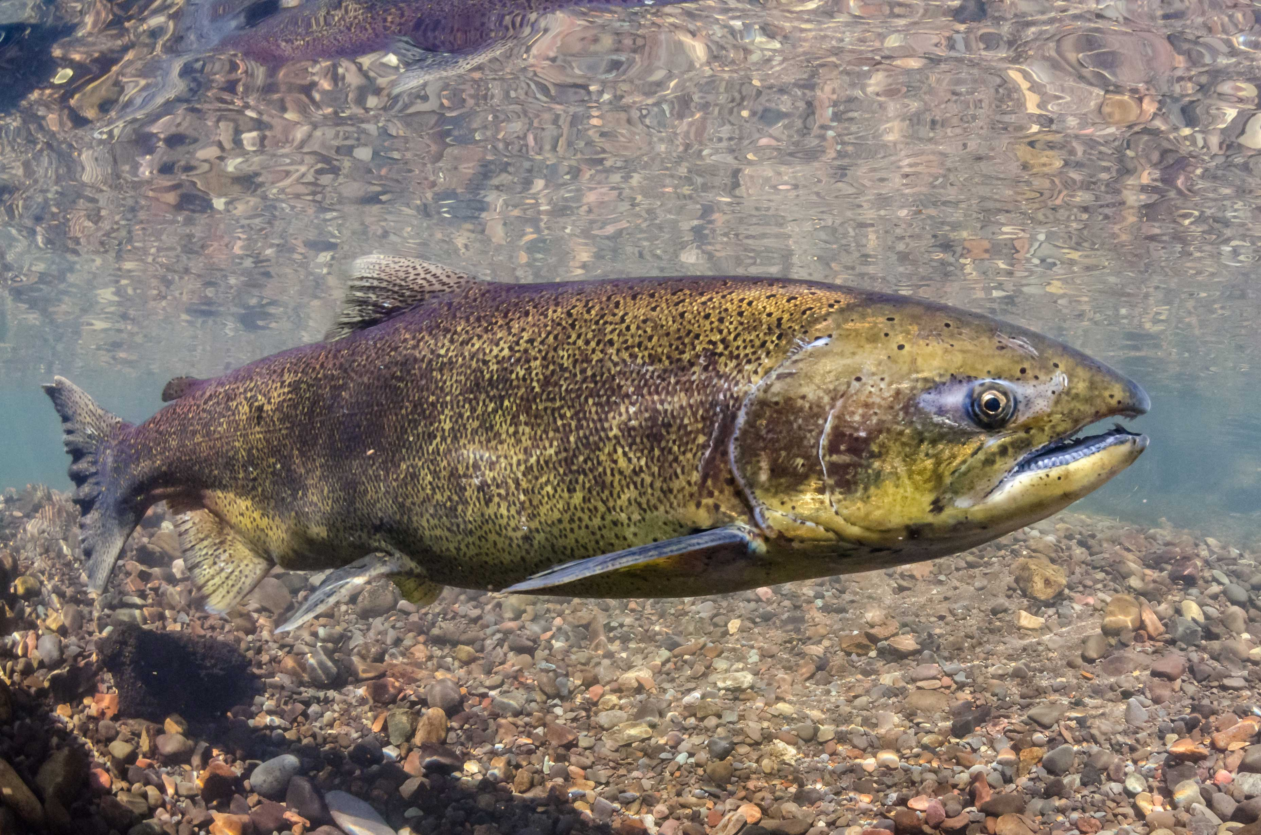
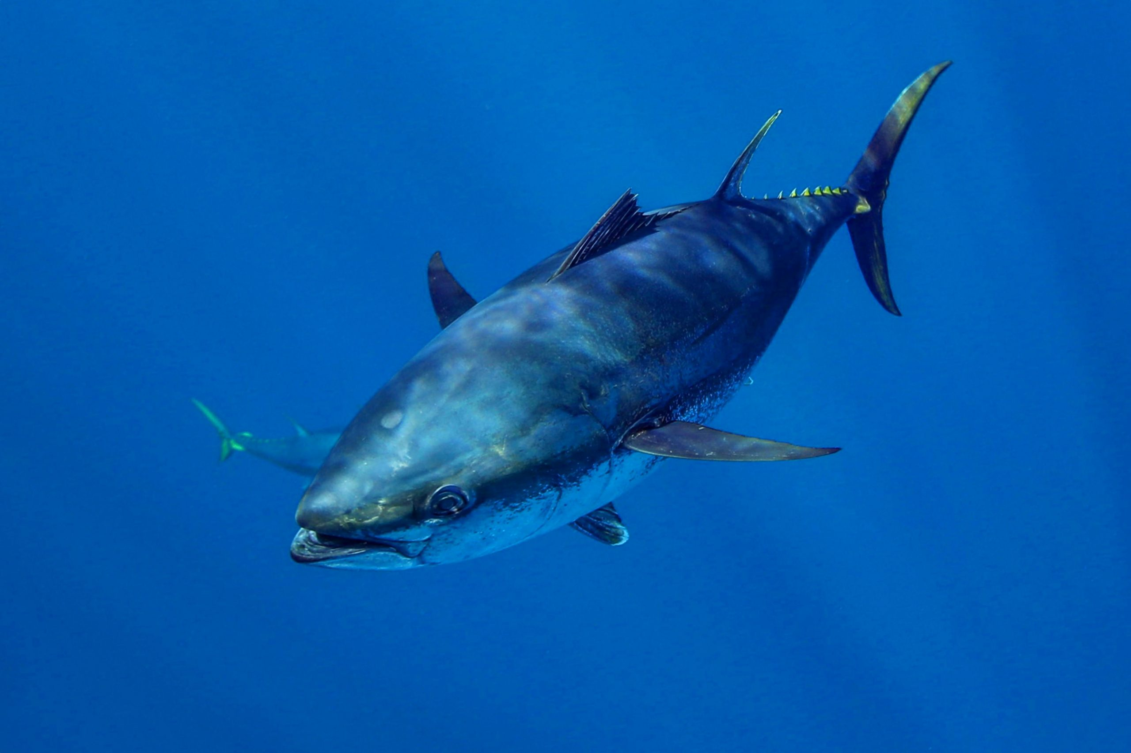
Urchin/abalone
Population declines due to loss of kelp beds.
Bocaccio
Enormously high recruitment rebuilds threatened fish stock.
Pacific cod
Population declines due to reduced prey and increased metabolic demands.
Shrimp
Major heatwave and climate change winner – but don’t know why yet
Dungeness crab
Fishery closures due HABs and whale entanglements.
Shortbelly rockfish
Increases in abundance approached bycatch limits in Pacific hake fishery.
Sardine/anchovy
Sardines low while anchovies high; surprise!
Market squid
Increases in distribution leads to unregulated emerging fishery.
Chinook salmon
Overfished due to reduced productivity and model failure.
Bluefin tuna
Increased abundance was a boon for the recreational fishing industry.
Direct negative impacts
Indirect negative impacts
Neutral
impacts
Positive impacts, w/ higher mgmt. challenges
Positive impacts, w/ lower mgmt. challenges
Ecological impact of the heatwave

